Slide 1
Team Ink3D Status 3/28/14
Daniel Lain
Tim Edmonson
Shawn Simonson
Jesse Bowles

Slide 2
Project Status
Task Number | Task Name | Planned Start | Planned Finish | Planned Work Hours | Actual Work Hours | % Work Completed | Earned Vaule
2 | Senior Design 2 | Wed 1/15/14 | Fri 5/23/14 | 762 | 307 | 33.07 | 252
2.1 | Documents | Wed 1/15/14 | Fri 5/23/14 | 242 | 256 | 100 | 242
2.1.1 | Detailed Design Documnetation | Tue 1/21/14 | Fri 2/28/14 | 142 | 212 | 100 | 142
2.1.1.1 | Version 1.0 | Tue 1/21/14 | Thu 2/20/14 | 72 | 208 | 100 | 72
2.1.1.2 | Version 2.0 | Wed 2/12/14 | Fri 2/28/14 | 70 | 4 | 100 | 70
2.1.2 | Test Plan | Thu 2/20/14 | Tue 3/18/14 | 100 | 44 | 100 | 100
2.2 | Prototype Implementation | Tue 2/18/14 | Thu 5/15/14 | 500 | 46 | 0 | 0
2.2.1 | Version 0.0 | Tue 3/18/14 | Tue 4/1/14 | 100 | 46 | 0 | 0
2.2.2 | Version 0.5 | Tue 3/4/14 | Tue 3/18/14 | 100 | 0 | 0 | 0
2.2.3 | Version 1.0 | Tue 3/18/14 | Tue 4/1/14 | 100 | 0 | 0 | 0
2.2.4 | Version 2.0 | Tue 4/1/14 | Tue 4/15/14 | 100 | 0 | 0 | 0
2.2.5 | Final Product | Tue 4/15/14 | Tue 4/29/14 | 100 | 0 | 0 | 0
2.3 | Final Documetation | Tue 4/1/14 | Tue 4/29/14 | 10 | 0 | 0 | 0
2.4 | Architecture Design Version 2.1 | Tue 1/21/14 | Mon 2/24/14 | 10 | 5 | 100 | 10
3 | Presentations | Fri 9/13/13 | Fri 4/25/14 | 49 | 49 | 89.8 | 44
3.4 | Detailed Design Review | Thu 2/20/14 | Tue 2/25/14 | 7 | 18 | 100 | 7
3.6 | Team Stauts Report SD2 | Thu 1/23/14 | Fri 4/25/14 | 8 | 4 | 37.5 | 3
4 | Team Meetings | Tue 9/10/13 | Tue 12/9/14 | 496 | 209 | 83.87 | 416
4.2 | Team Meeting SD2 | Tue 1/14/14 | Thu 5/1/14 | 272 | 101 | 70.59 | 192
5 | Sponser Meetings | Mon 9/9/13 | Tue 9/9/14 | 30 | 20 | 0 | 0
6 | MS Project | Sun 9/29/13 | Thu 10/23/14 | 40 | 30 | 50 | 20
6.2 | SD 2 | Thu 1/23/14 | Thu 1/23/14 | 20 | 8 | 0 | 0

Slide 3
Database
Implemented
24/24 Commands in CommandStructure
XmlPersistenceFramework
24/26 Tests (complete by Tuesday)
XmlPersistenceFramework
GetPrintJobConfguration
Issues
Rethink DB and Mater Configuration
JaxB Issue

Slide 4
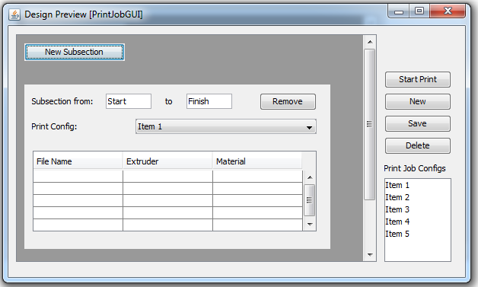
GUI Progress

Slide 5
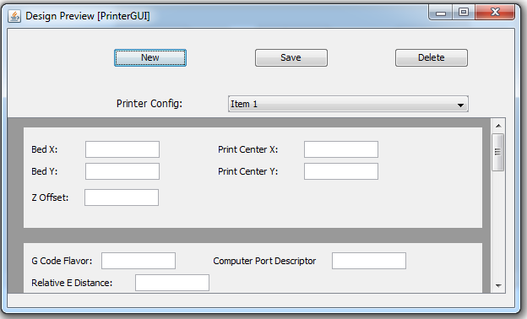
GUI Progress

Slide 6
Processing Layers
Implementations Completed
Object File Translation Module
Subsection Module
Testing Completed
Object File Translation Module
In progress
Subsection Module Testing
Slicing Engine Module Implementation
By Tuesday
Processing Layers complete (implementation and testing)

Slide 7
Communications Layer Updates
Progress
Test program tested on virtual serial device
Live test session scheduled for next week
Communications layer (first iteration) on track for completion 4/1
Issues
Printer access
Multiple Windows drivers for printer hardware. (May be trial and error)
Looking Forward
Finalize communications layer based on live tests
Begin implementation of Printer Control Layer

Slide 8
Next Steps
Finish Stage One
DB
Processing Layers
Communications Layer
Start Stage Two
GUI / Controller part 1
Printer Control Layer

